Slide 1
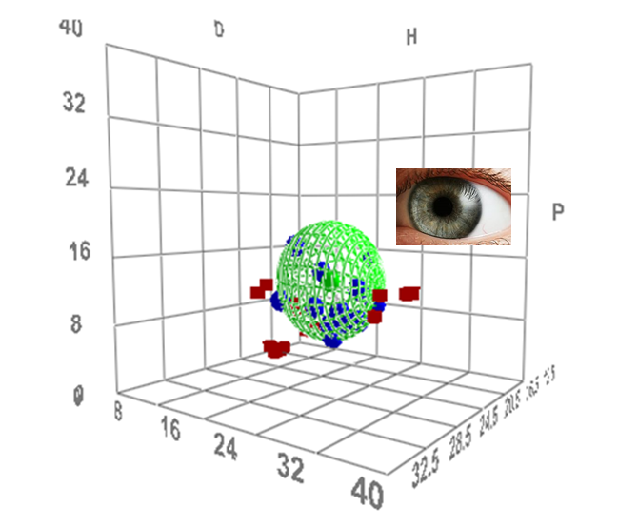
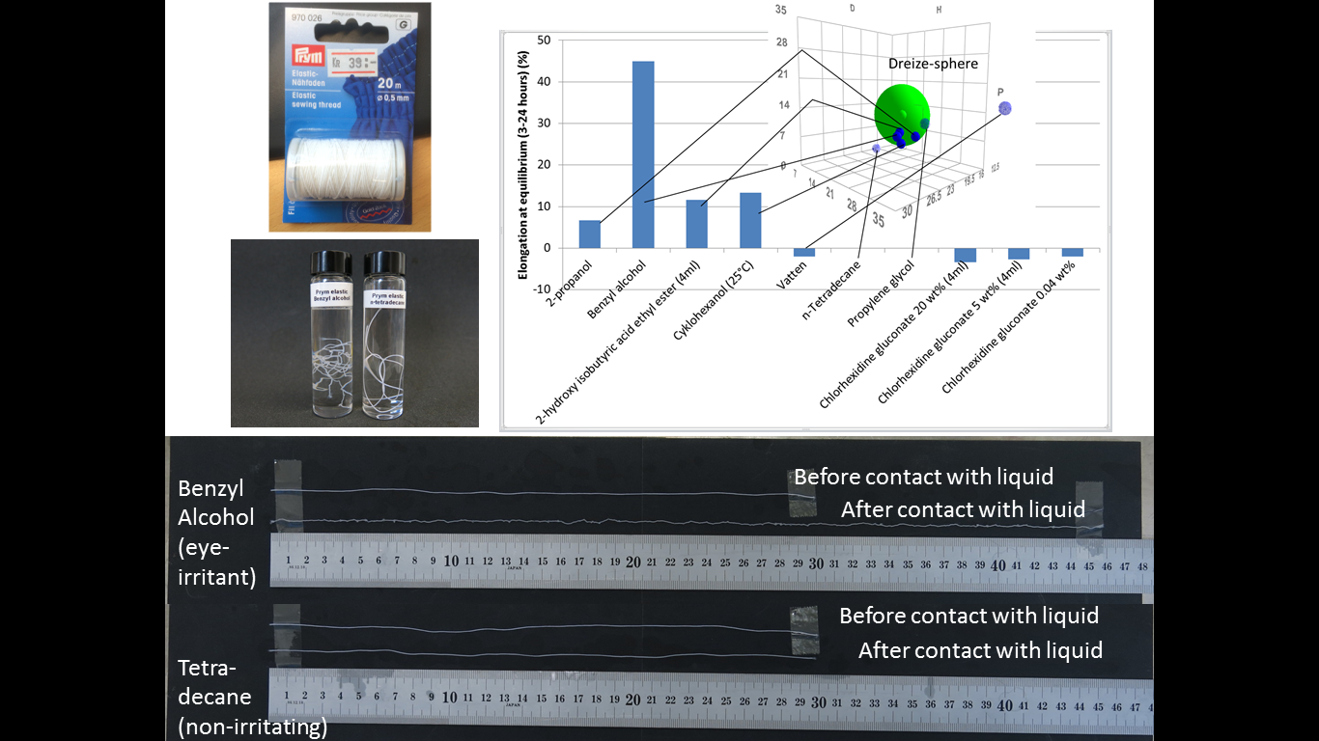
Prediction of eye-irritation with HSPiP and via elongation of polymer threads
Presenter:
Martin Andersson (martin.andersson@ri.se)
Team: Martin Andersson, Mimmi Eriksson, Jonas Enebro, Jens Sommertune, Lovisa Ringstad,
Kristina Fant and Benny Lyvén
(RISE Research Institutes of Sweden AB)

Slide 2
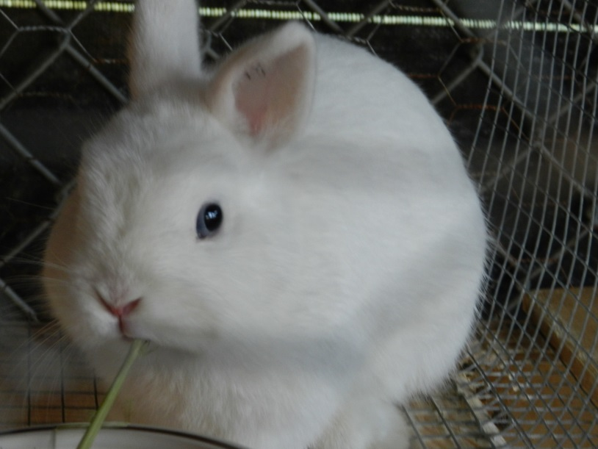
Important that products are non-irritating to the eye
Many in vitro methods are in place
The Draize eye-irritation test is always the last resort
Despite this – 10:ths of thousands of rabbits used so far in REACH registrations…

Slide 3
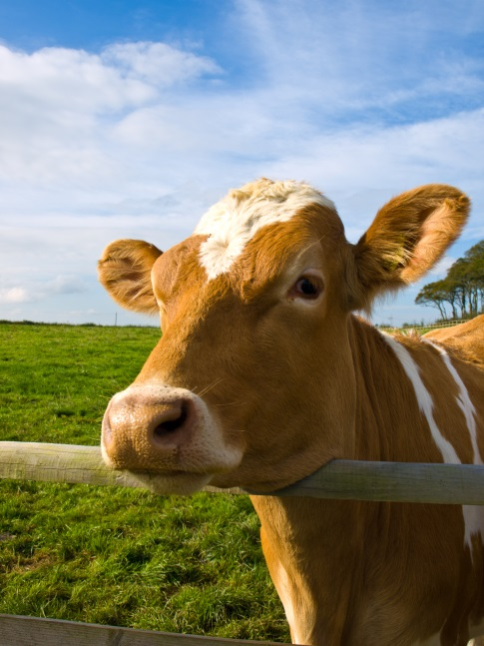
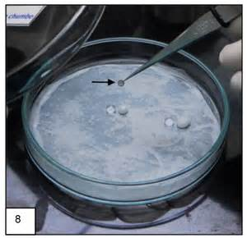
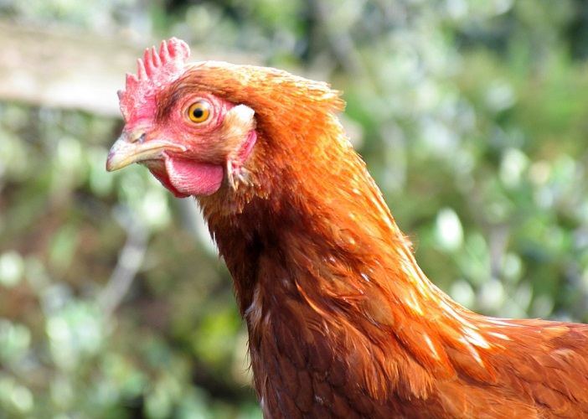
OECD in-vitro-methods for assessment of eye-irritation requires biological samples or cultured cell-lines
http://www.oecd-ilibrary.org/environment/oecd-guidelines-for-the-testing-of-chemicals-section-4-health-effects_20745788

Slide 4
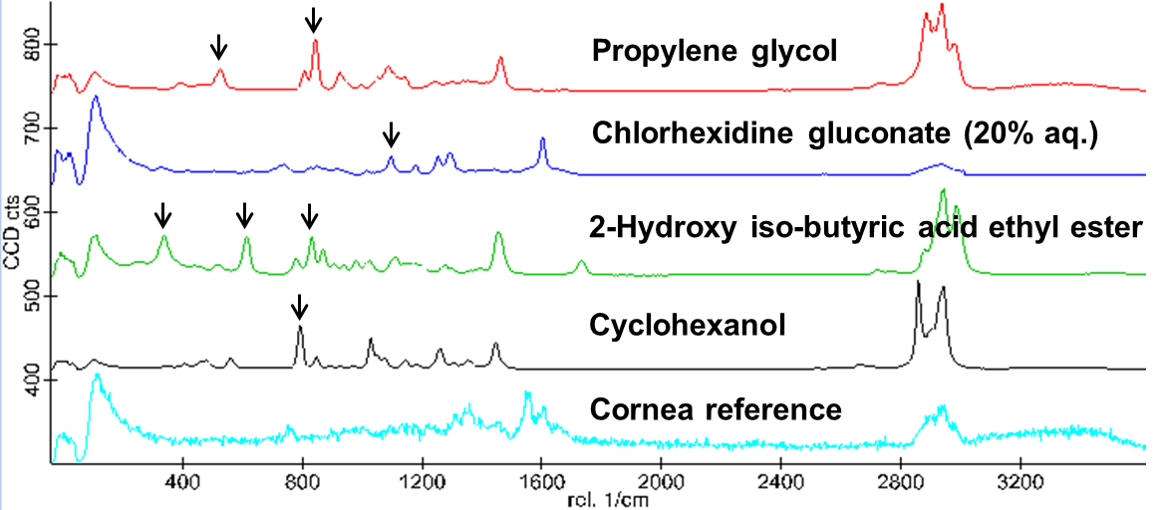
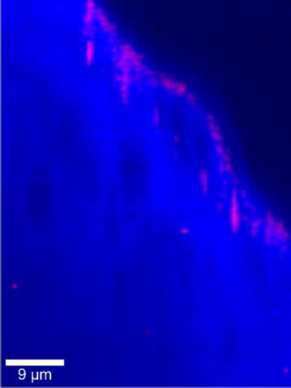
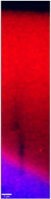
Confocal Raman Microscopy (CRM) examination of solvent-treated porcine corneas
Test chemical applied (10 minutes at 32°C)
Rinsed with Hank’s Balanced Salt Solution
Examined by CRM
Every pixel is a full Raman spectrum!
Exp 1:1
20 min
For each spectrum the best linear combination
of solvent and cornea spectra is computed and plotted:
Red = solvent
Blue = cornea
65 min
110 min
Propylene glycol
(non-irritant)
2-Hydroxy
iso-butryic acid
ethyl ester (severe irritant)
Helga Rothe¹, Birgit D. Brandner², Lovisa Ringstad², Pauline McNamee³
¹Procter & Gamble Service GmbH, Schwalbach, Germany, ²RISE Research Institutes of Sweden, Stockholm, Sweden; ³Procter & Gamble Egham, UK

Slide 5
Idea:
Could we treat the cornea as a polymer…
…and use HSPiP?

Slide 6

Three findings

Slide 7
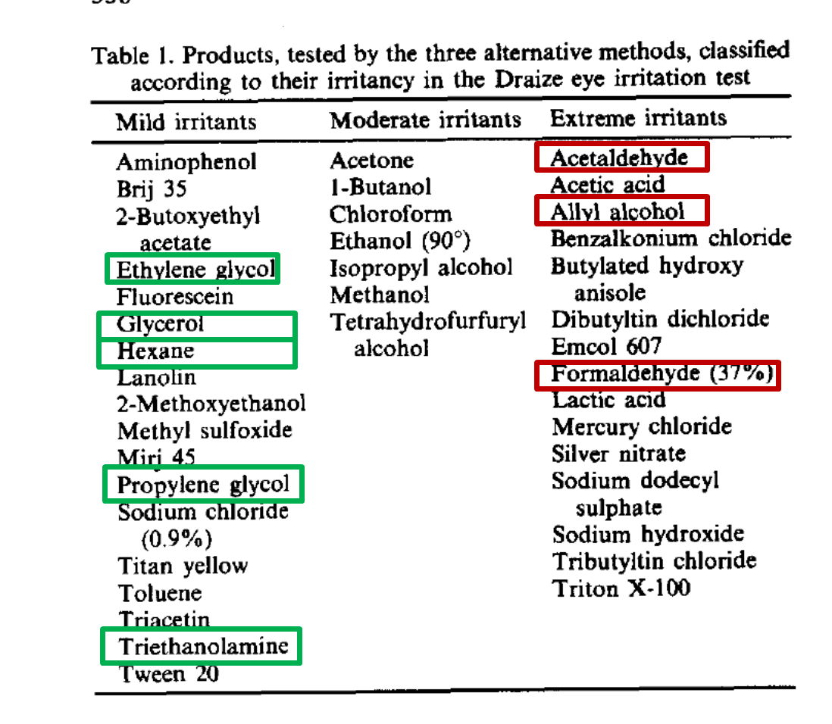
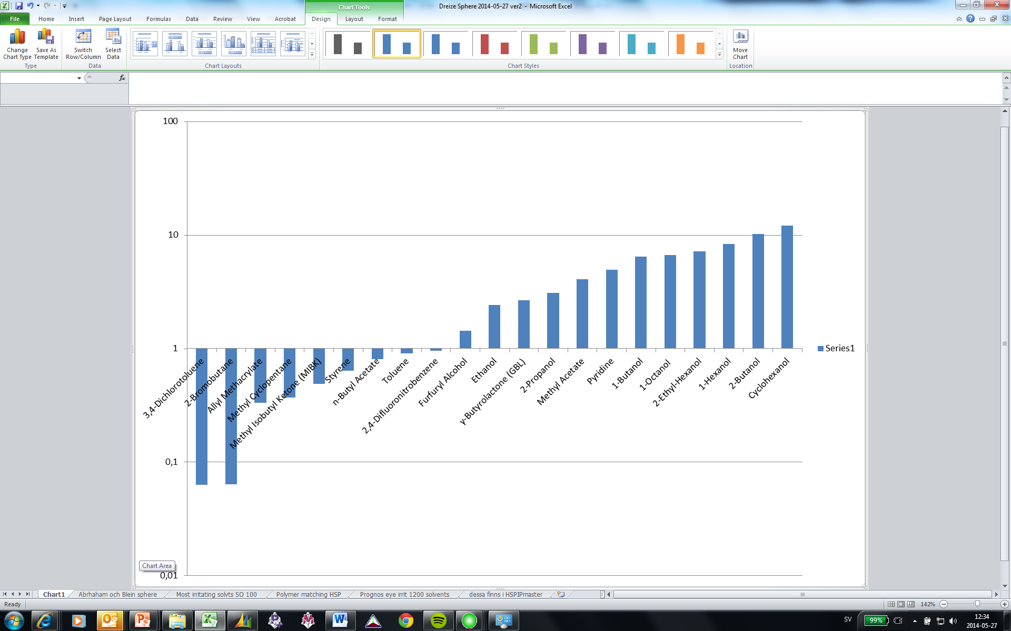
A set of known ey-irritant and non-eye-irritant liquids were selected
Irritating
(blue spheres)
Non-irritating
(red cubes)
21 liquids
(based on Draize scores recalculated from Abraham et al using P_{vap} )
…and 8 liquids from Blein et al.
Michael H. Abraham, Mostafa Hassanisadi, Mehdi Jalali-Heravi, Taravat Ghafourian, William. S. Cain,
and J. Enrique Cometto-Muniz, TOXICOLOGICAL SCIENCES 76, 384–391 (2003) DOI: 10.1093/toxsci/kfg242
O. Blein, M. Adolphe, B. Lakhdar, J. Cambar, G. Gubanski, D. Castelli,C. Contiei, F. Hubert, F. Latrille, P. Masson, J. Clouzeau, J. F. Le Bigot, O. De Silva and K. G. Dossou, Toxic. in Vitro Vol. 5, No. 5/6, pp. 555-557, 1991

Slide 8
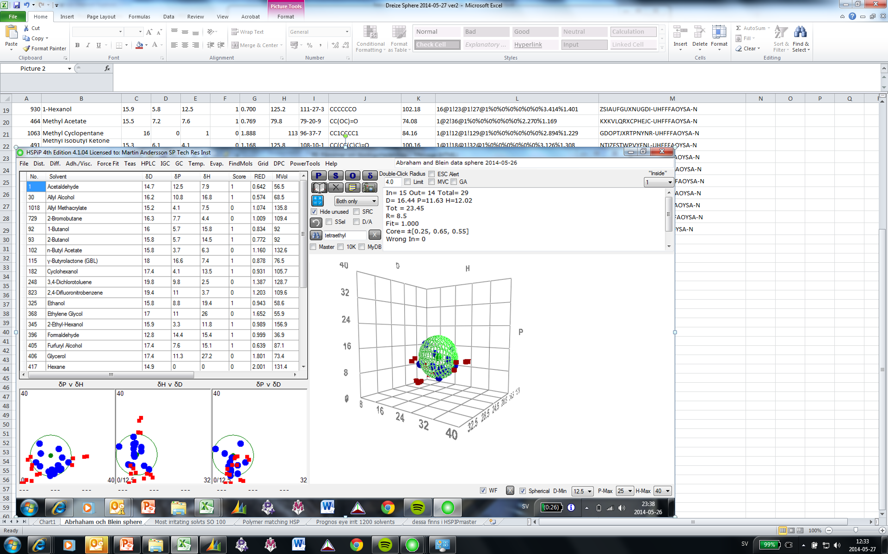
Finding 1:
All 15 irritating liquids fall inside a well definded Hansen sphere!
All 14 non-irritants scatter outside the sphere!

Slide 9
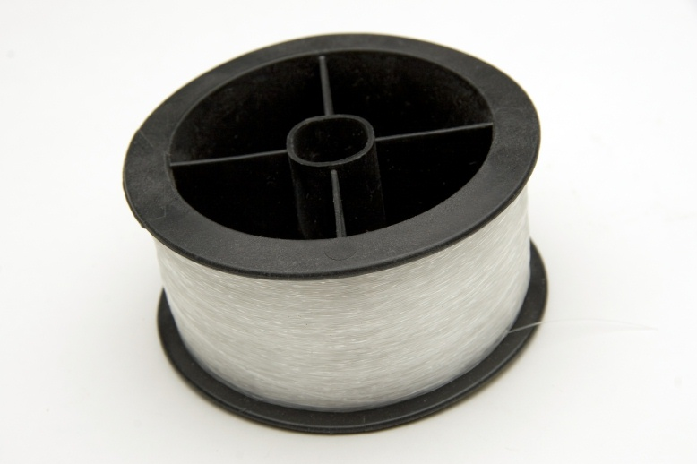
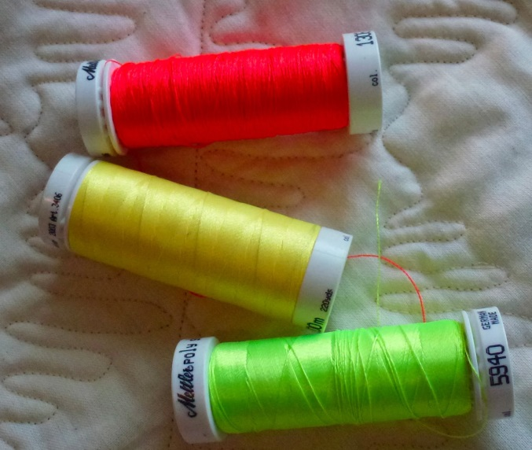
OK!
So which synthetic polymer is most similar to the cornea?
?
?

Slide 10
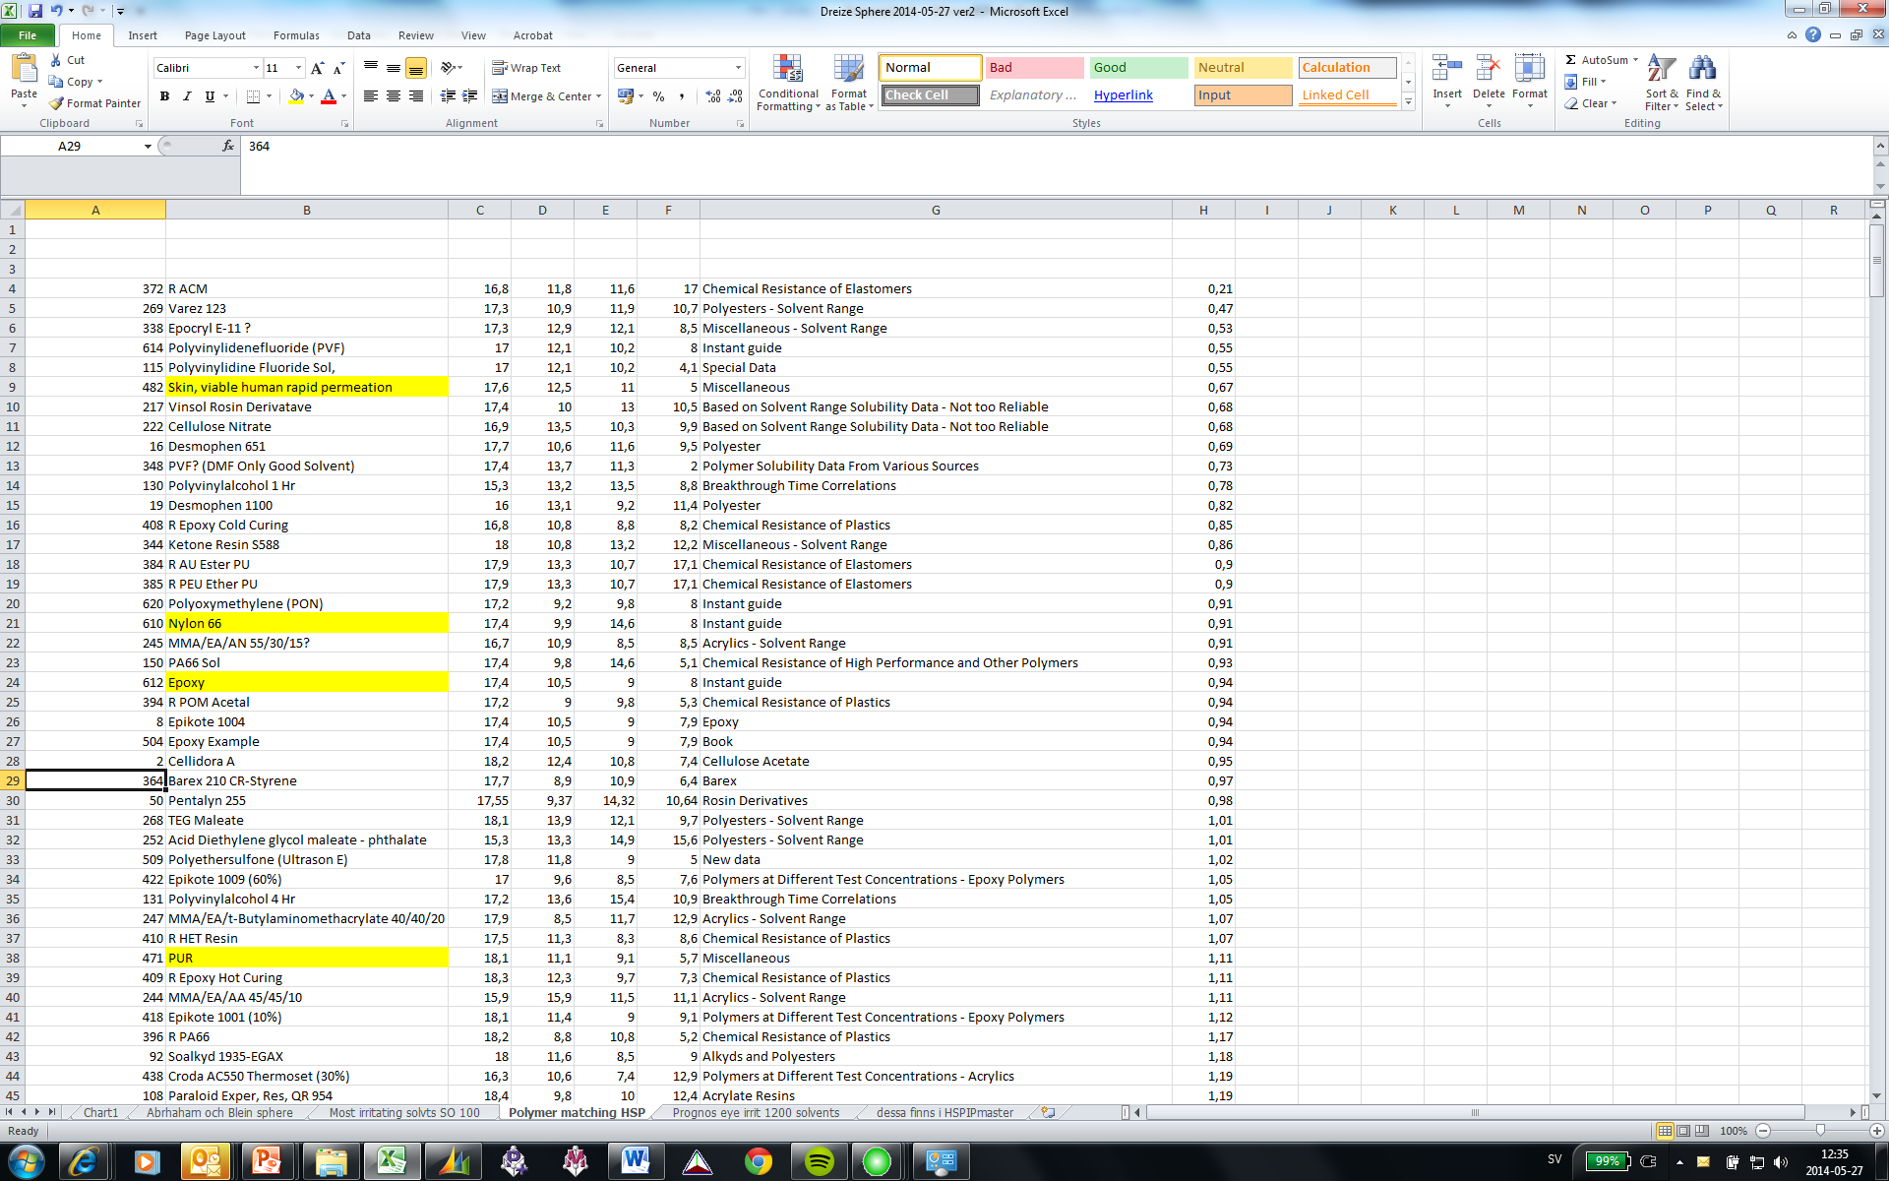
Acrylate rubber
HSPiP score

Slide 11
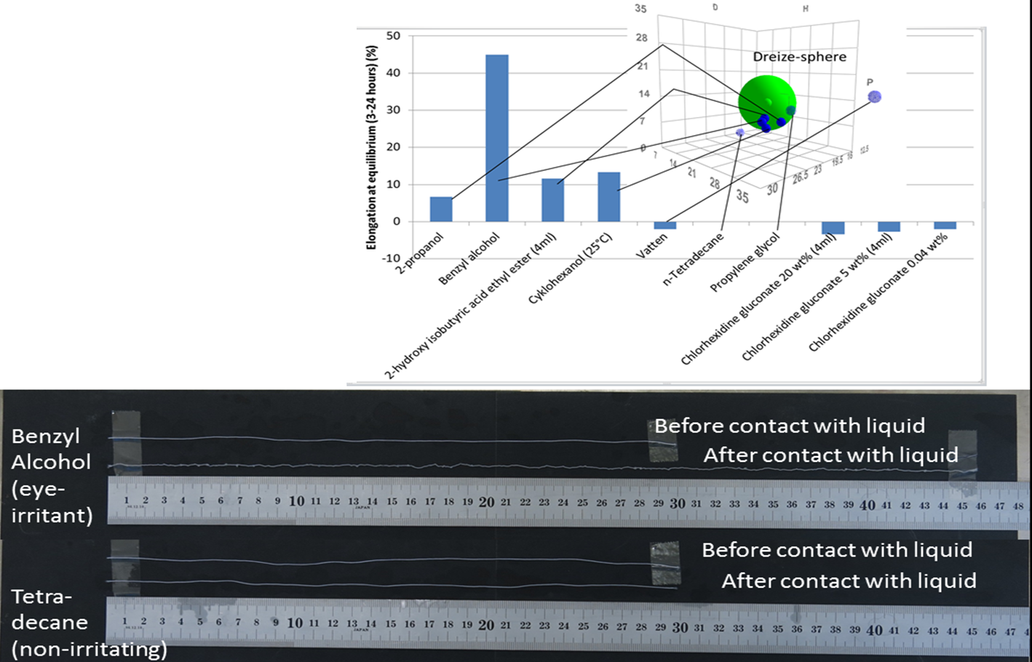
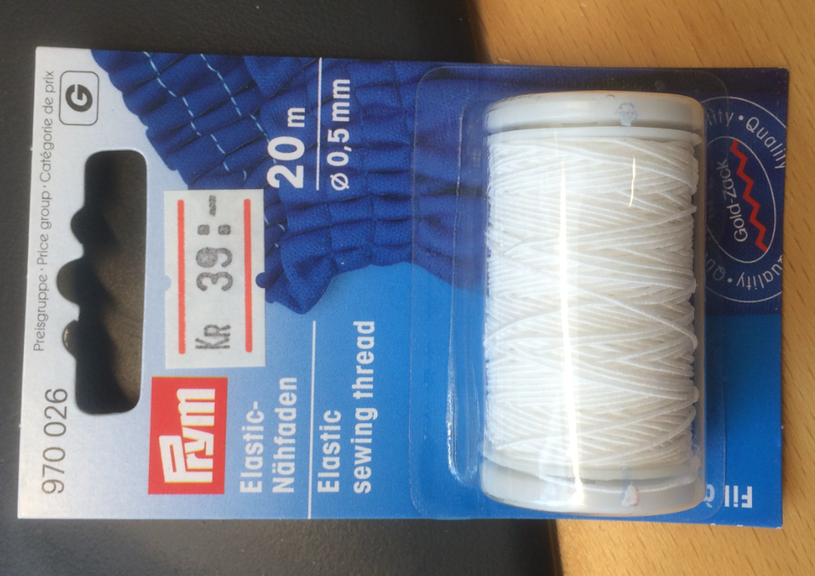
Finding 2:
Elongation of a elastan/polyamid thread dipped in a liquid seems to correlate with its eye-irritation.
Up to ca 50% elongation in irritants
No elongation in non-irritants
Equilibrium after 3 hours.
Water
(Prym elastic sewing thread 0.5 mm, 50% elastan, 50% polyamide – best so far!)

Slide 12
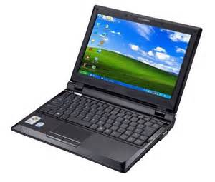
So…could HSPiP be used to predict
eye-irritation in-silico?

Slide 13
Random selection of 27 substances from the HSPiP-database
Dossiers at https://echa.europa.eu were studied
Acids and obviously reactive compounds removed (22 compounds left)

Slide 14
RED (relative to ”Draize sphere”)
Outside of the sphere
Inside the sphere

Slide 15
Finding 3:
Many mechanisms for irritation – precipitation, etching, mechanical etc
pH, redox and reactivity/precipitation etc needs to be taken into account
- HSP is only one part of this.
More data needed

Slide 16
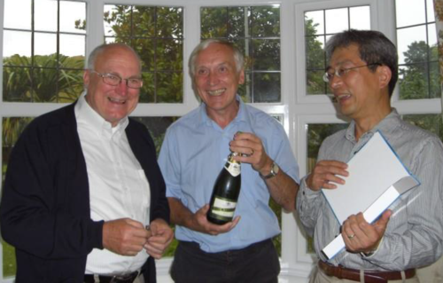
Coclusions and Next steps
Promising indications – (but too early for champagne… ☺)
Further development and validation needed
More polymers will be evaluated
A successful method could be useful as a pre-scereening step, to remove irritating candidates early in trials.
Plans (and funding!) in place!

Slide 17

The team:
Martin Andersson, Mimmi Eriksson, Jonas Enebro, Jens Sommertune, Lovisa Ringstad, Kristina Fant and Benny Lyvén

Slide 18

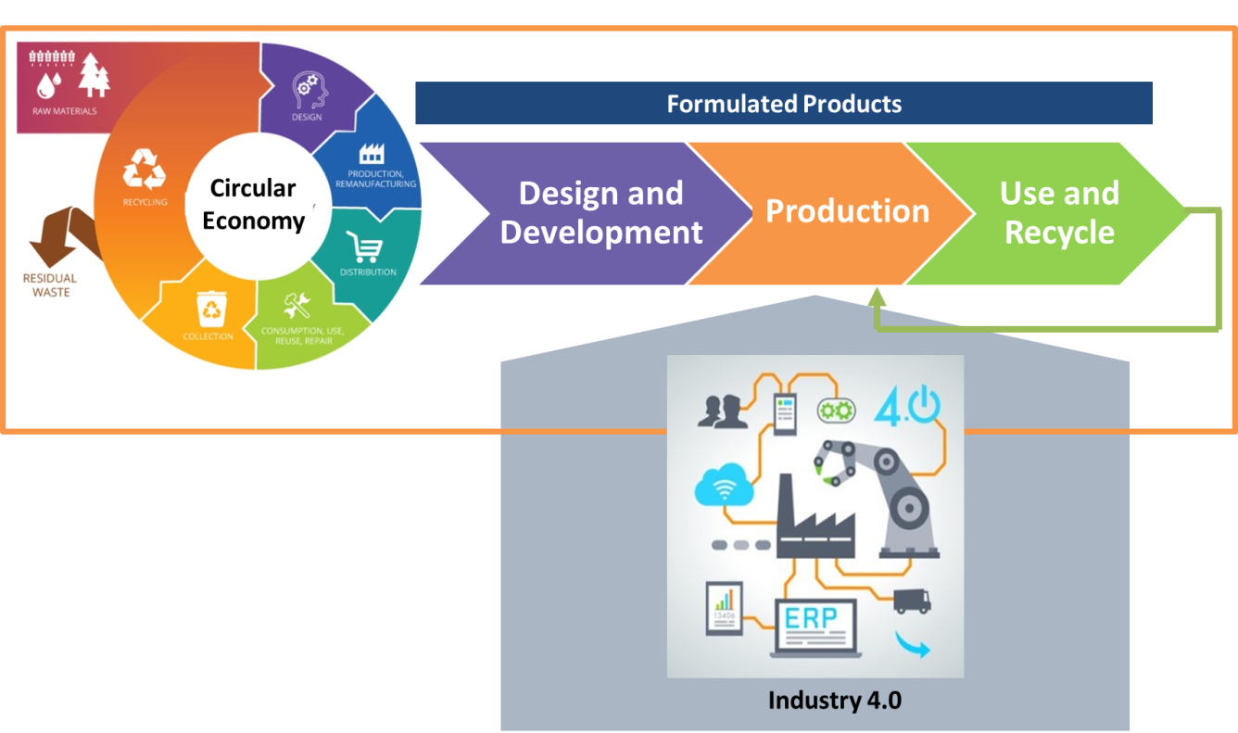
Horizon 2020 Coordination and Support Action (CSA) project
Oct 2016- Oct 2018
Objectives
Establish a European Formulation Interest Group (EU-FIG)
Identify common technical and industrial challenges for the European Formulated Products Industries*
Establish a common vision and roadmap
Arrange knowledge exchange activities and facilitate new initiatives along the value chain
Home & Personal care
Pharma
Agro
Coatings
Food
Advanced materials
Key project output
Influence the content of future EU calls
EU-FIG community with >500 organizations
> 10 new collaborative cross-sectorial initiatives
On line survey Feb – May 2017!
www.formulation-network.eu

